Slide 1



University Institute of Liberal Arts and Humanities
Course Name – Communication Skills
Course Code – 23PCH-105
SUMMARIZING
DISCOVER . LEARN . EMPOWER

Slide 2
COURSE OBJECTIVES
The Course aims to:
1 | Augment students overall communication and interpersonal skills by making them realize the importance of good oral and written English Language in professional life.
2 | Enrich their reading capability with special emphasis on expanding vocabulary and grammatical formations.
3 | Build exceptional speaking, reading and writing skills by correcting grammatical errors and pronunciation through practice.
4 | Enhances soft skills by fostering self awareness, confidence and a positive attitude in students’ ability to communicate effectively in English.

Slide 3
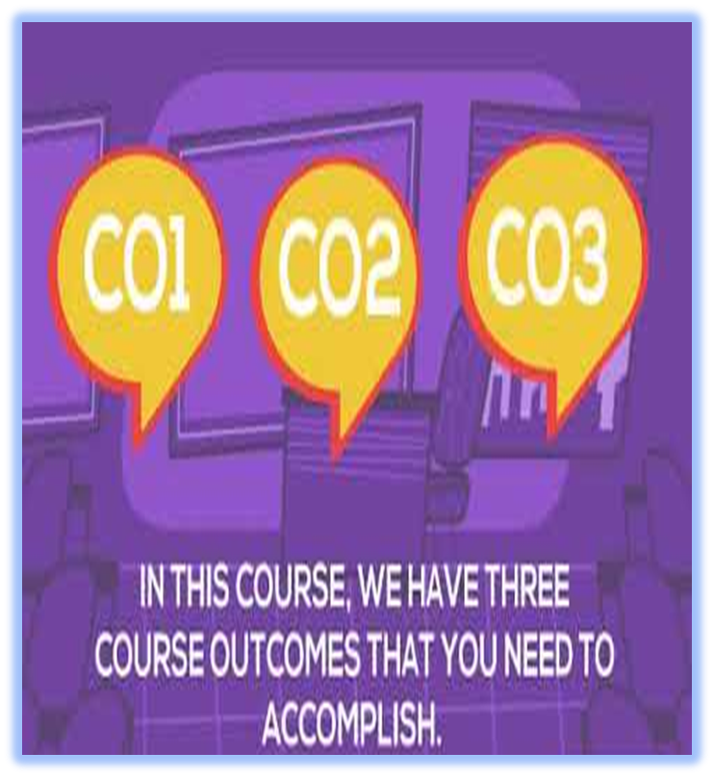
COURSE OUTCOMES
On completion, the students are expected to
CO Number | Title | Level
CO1 | Apply appropriate Listening, Speaking, Reading and Writing Skills (LSRW Skills) with correct non-verbal cues to attain expertise in soft skills. | Apply
CO2 | Apply correct contextual and comprehensible written text in the form of paragraph writing, short compositions business correspondence, using logical support and argument in a wide range of communication situations. | Apply
CO3 | Demonstrate linguistic competence while speaking and during presentations through accuracy in grammatical usage, vocabulary, pronunciation and intonation. | Apply
CO4 | Evaluate information as critical readers, speakers and writers applying ethics in communication and being sensitive in cross cultural communication. | Evaluate
CO5 | Create original, digital content for websites, blogs, vlogs and personal social media profiles etc. | Create
www.imgbin.com

Slide 4
SUMMARIZING
Definition:
A summary is a brief overview of an entire discussion or argument. It summarize a whole research paper or conversation in a single paragraph. A summary gives the reader a condensed account of the main ideas in a text.
Let’s discuss the deference between summarizing and paraphrasing.

Slide 5
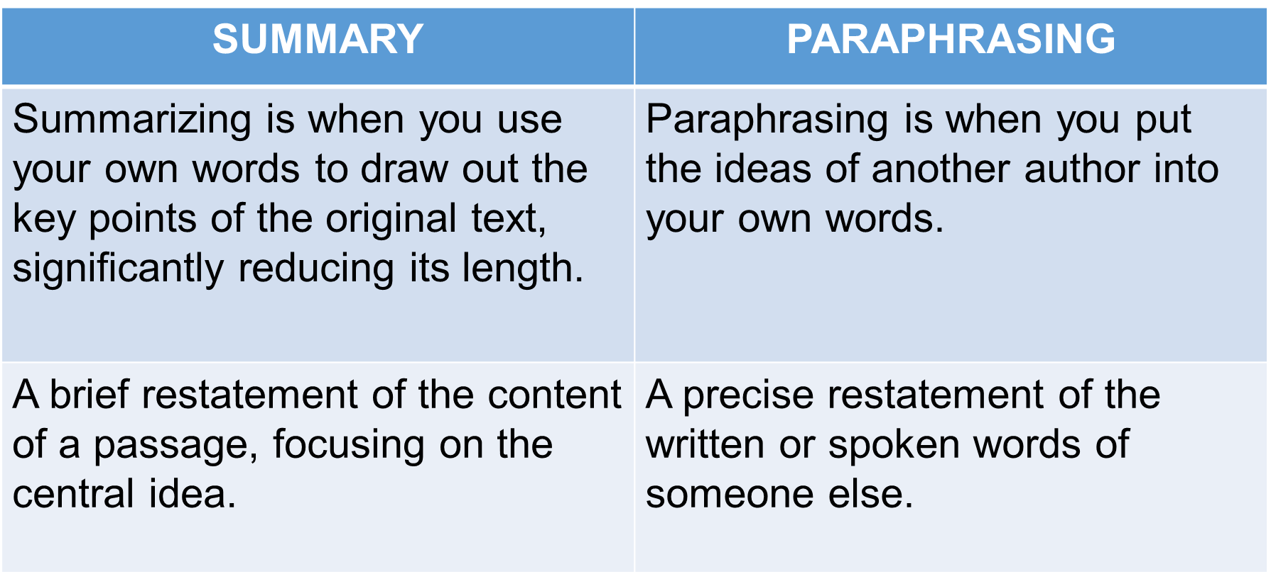
Difference Between Summary and Paraphrasing

Slide 6
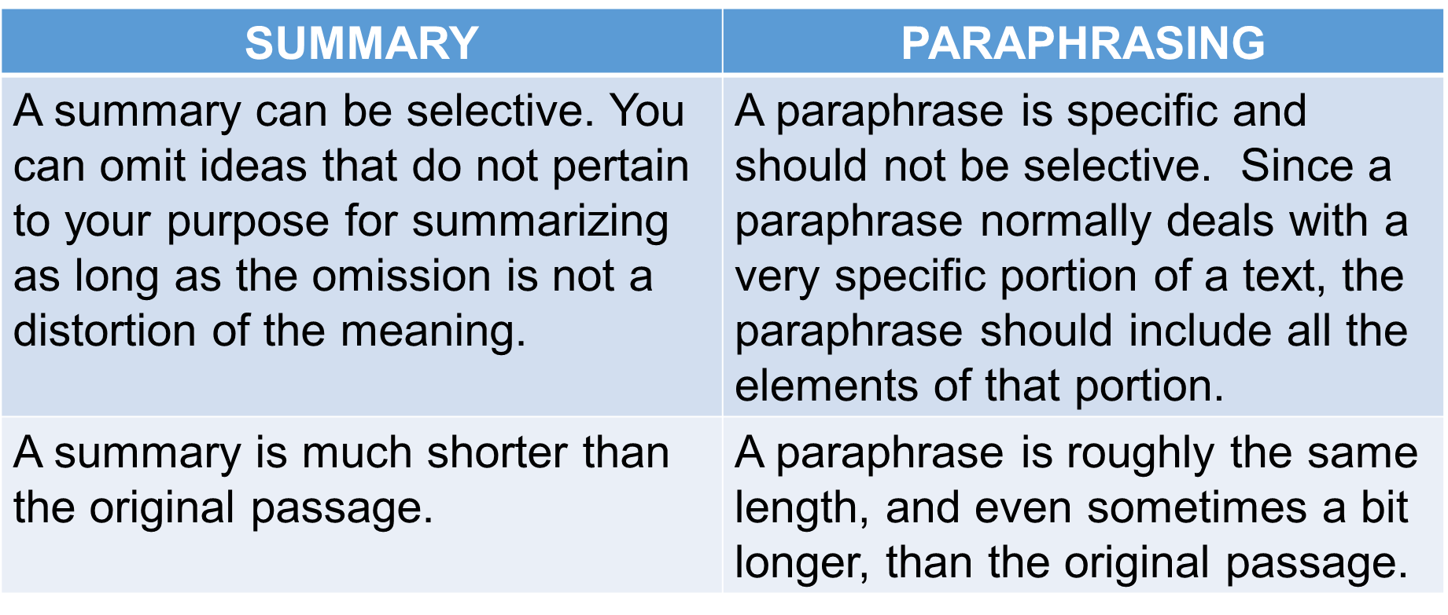
Difference (Cont….)

Slide 7
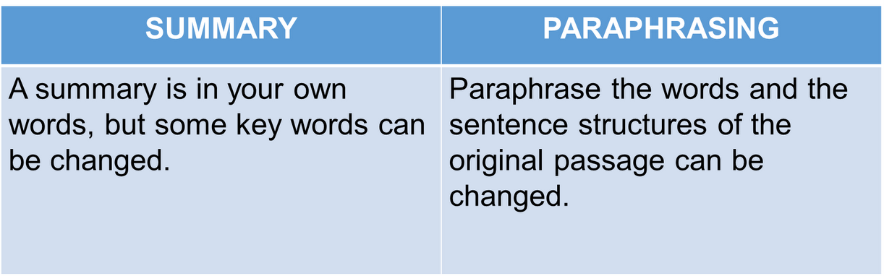
Difference (Cont….)

Slide 8
Important Points
Summary reports accurately and objectively what the original author has said. It addresses the following:
the subject of the article
the author’s main point
the kind of evidence the author uses: Scientific studies? Personal research or experience?
the author’s conclusions: What does the author want the reader to think about this topic?

Slide 9
Poll Question: 1
Which one of the followings is not a part of Summary?
using your own words
summary being shorter than the text
exact word from the text
including main ideas only

Slide 10
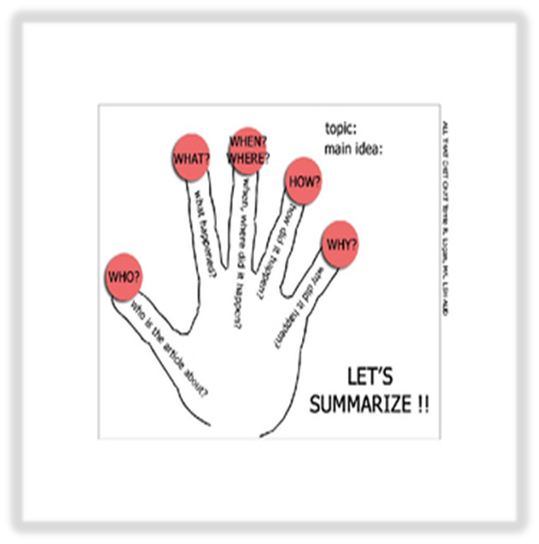
Process of Writing Summary
Preview
Read
Thesis and One-sentence Summaries
First Draft
www.teacherspayteachers.com

Slide 11

Summary Writing Tips
Read the chapter thoroughly
Break down ideas
Write in column
Always write a rough draft
www.weiweics.com

Slide 12
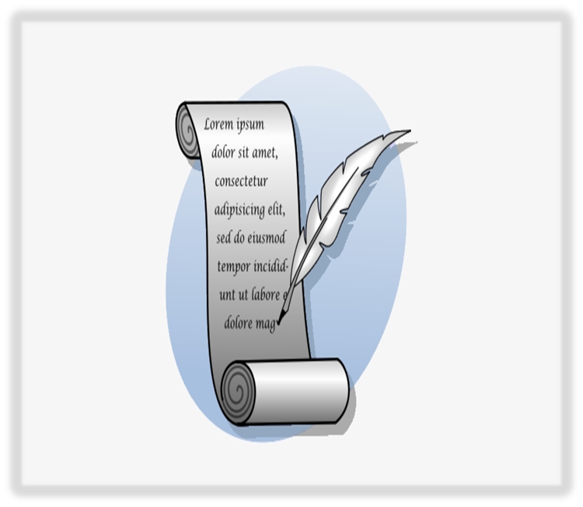
Writing Tips…..
Take your time
Use sentence variety
Revise the summary
Write an interesting title
www.pngkey.com

Slide 13
Poll Question :2
What should we do before write final draft of summary?
write the facts and dates in bold
underline the difficult words
revise the summary
make 2-3 paragraphs of summary

Slide 14
Exercise
Choose the Right Option
In a very happy mood, he read the letter in which it was stated that he had been accepted into the university.
In a very happy state, he read his university acceptance letter.
He was in a happy state when he was reading the acceptance letter from the university .
Happily, he read his university acceptance letter.
He was happy when the letter came .
a

Slide 15
Sample Passage
There are times when the night sky glows with bands of color. The bands may begin as cloud shapes and then spread into a great arc across the entire sky. They may fall in folds like a curtain drawn across the heavens. The lights usually grow brighter, then suddenly dim. During this time the sky glows with pale yellow, pink, green, violet, blue, and red. These lights are called the Aurora Borealis. Some people call them the Northern Lights. Scientists have been watching them for hundreds of years. They are not quite sure what causes them. In ancient times Long Beach City College WRSC Page 2 of 2 people were afraid of the Lights. They imagined that they saw fiery dragons in the sky. Some even concluded that the heavens were on fire.

Slide 16
Final Summary
“The Northern Lights”
The Aurora Borealis, or Northern Lights, are bands of color in the night sky. Ancient people thought that these lights were dragon on fire, and even modern scientists are not sure what they are.

Slide 17
Application
It will help students learn to determine essential ideas and consolidate important details that support them.
It will enable students to focus on key words and phrases of an assigned text that are worth noting and remembering.
It will encourage students to write successively shorter summaries, constantly refining their written piece until only the most essential and relevant information remains.

Slide 18
References
http://www.uefap.com/reading/exercise/menu_nt.htm
https://www.amazon.com/Emily Kissner/e/B001JRTCVQ/ref=dpbylinecontpopbook_1(Summarizing, Paraphrasing, and Retelling: Skills for Better Reading, Writing, and Test Taking 1st Edition)
https://www.amazon.in/ A Practical Course for Developing Writing Skills in English Kindle Edition by J.K. Gangal
https://igcse1english.wordpress.com/category/paper-2-question-3-summary-writing/

Slide 19

THANK YOU
For queries
Email: communicationskills.uilah@gmail.com

